Slide 1
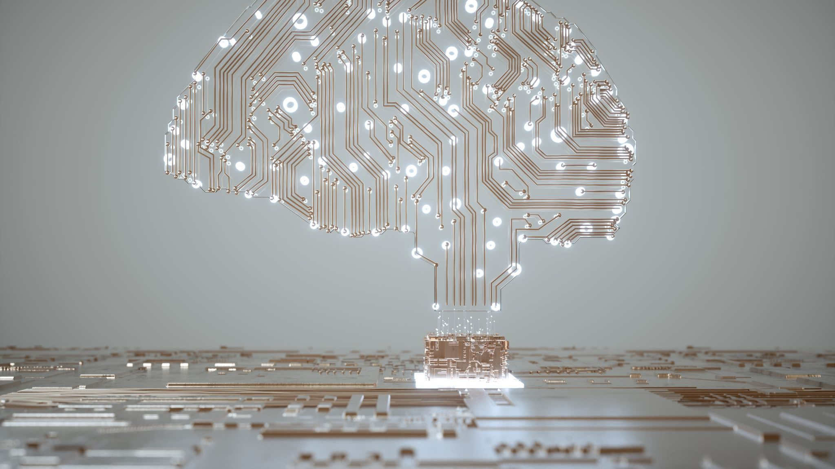
Artificial Intelligence (AI)
Year 3 - 4

Slide 2
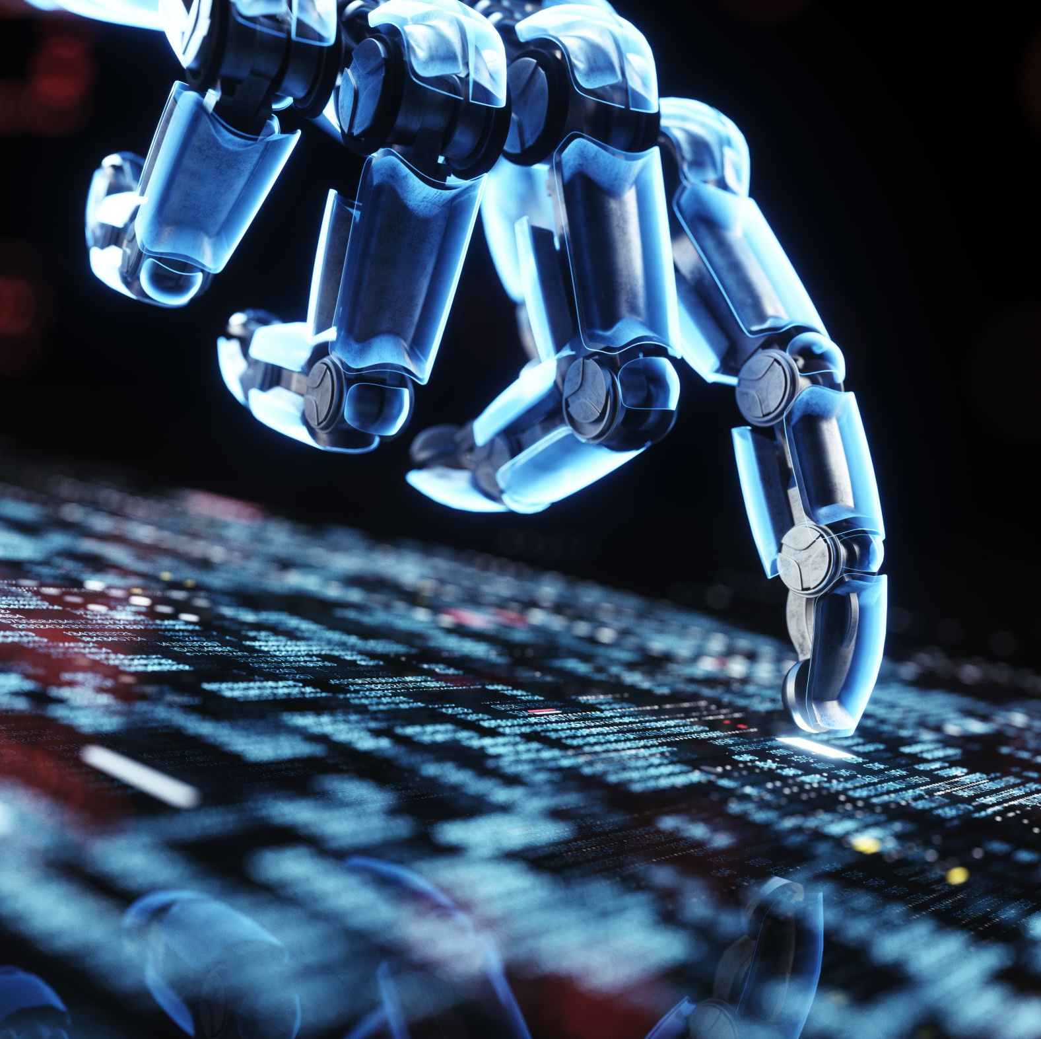
What is Artificial Intelligence (AI)?
A program made by people that makes computers do things that seem intelligent (or smart) in the same way that humans are intelligent

Slide 3
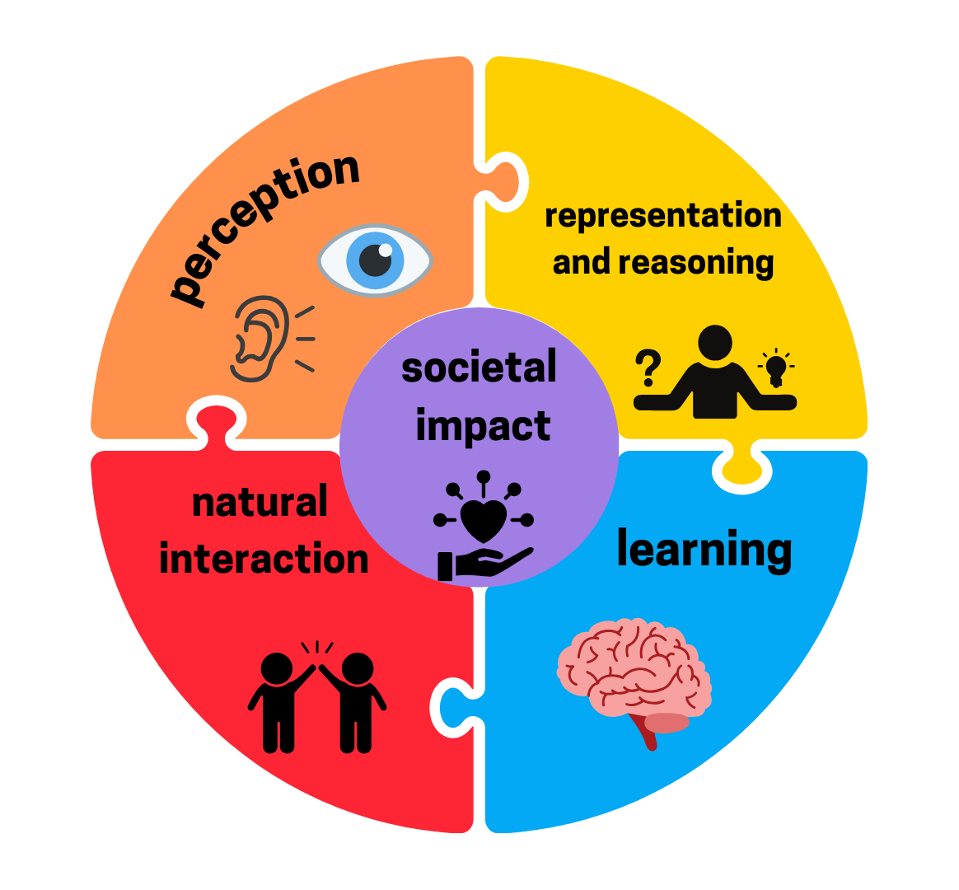
Concepts of AI
For a device to be artificially intelligent it must do one of the following 5 things

Slide 4

Three Steps to Machine Learning
It starts with a dataset: that’s like the information or examples the machine is shown.
Then, a learning algorithm looks for patterns in that data, like your brain figuring out how to solve a puzzle.
Once it’s learned enough, the machine makes a prediction; it tries to guess or decide something based on what it knows.

Slide 5

Datasets
As humans, we predict and make decisions about things without even thinking about it, based on our own datasets created by our previous experiences
For example, if you see a birthday cake that you’ve never had, you can decide whether you will probably like it based on similar things you have tried.

Slide 6
AI Datasets
Machines require lots of data and can be in the form of:
Images
Measurements
Text
Video recordings
Example data: https://quickdraw.withgoogle.com/data

Slide 7

What is an algorithm?
A set of rules or steps to solve a problem or achieve a specific goal
3 main parts of an algorithm:

Slide 8
Creating our own Algorithm
Scratch: https://scratch.mit.edu/

